Slide 1
Tutorial 9: Python - Basics
CS 104/108
Spring, 2024-25
TA: Mohana Evuri
Credits: Sabyasachi S. (2023 - 24 TA)

Slide 2
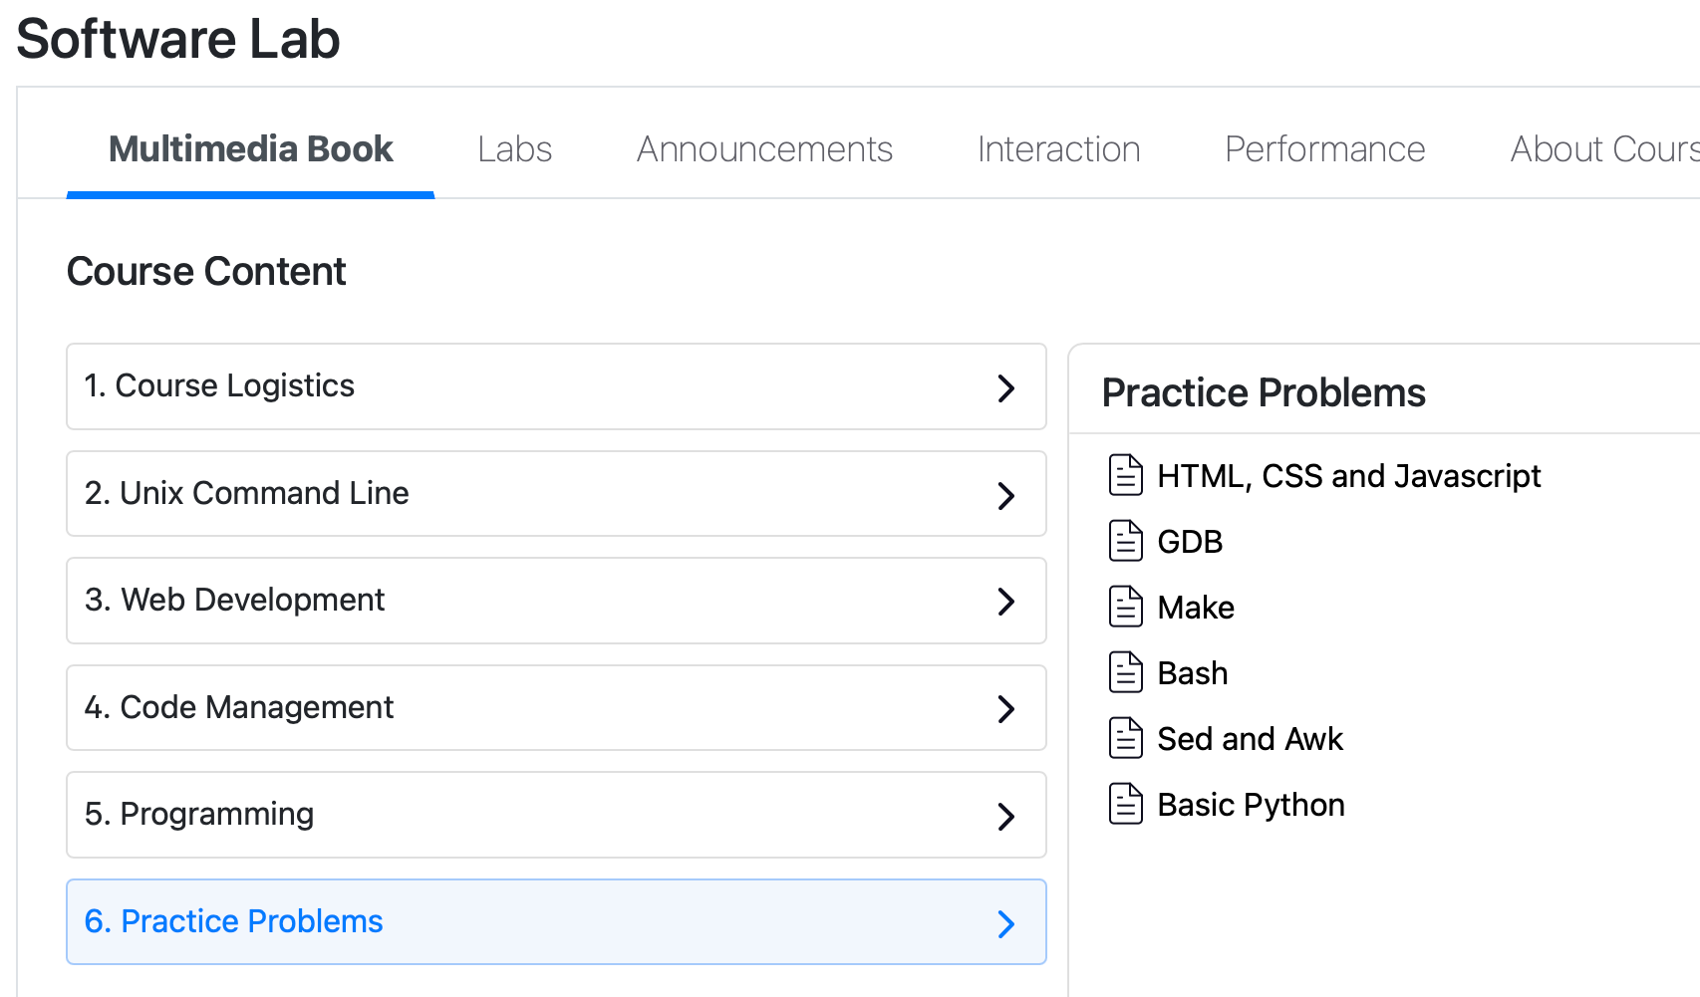
Practice Problems apart from the Labs
Extra practice problems (with no proper solutions/autograders) are put up on BodhiTree.

Slide 3
Topics
Variables
Operations
Strings
Collections
Conditionals and Loops
Functions
Class
Modules
File Handling

Slide 4
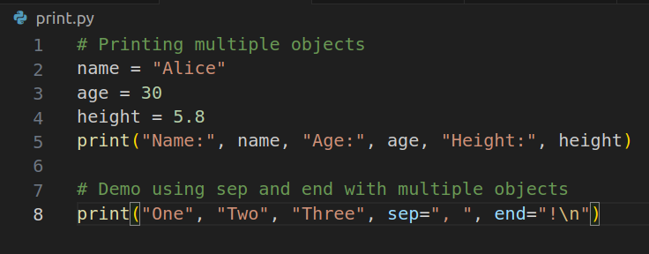

Print Function
The print() function is used to display information on the terminal/console.
Arguments can be strings, numbers, or any objects. They are converted to the "str" datatype before printing.
By default, multiple arguments are printed space-separated and terminated with a newline ("\n").
The sep parameter can be used to change the separator between printed objects.
The end parameter can be used to change the line ending.
print.py is provided.

Slide 5
Intro - Variables, Comments
Variables are labels assigned to refer to a value or class object
Python being an intelligent language, is dynamically-typed, i.e, variables need not be explicitly declared and can be overridden with other types, unlike C/C++.
Nevertheless, casting can be used to specify the data-type
Single-line comments start with #.
Multi-line comments can be enclosed within triple quotes (''' or """).
Rule: Variable names can only contain letters, numbers and underscore. No spaces!
Advice: Avoid using keywords as variable names: Eg: final, int, float
Note: There is no concept of const in Python

Slide 6
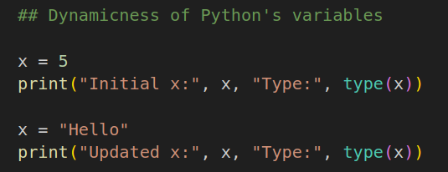
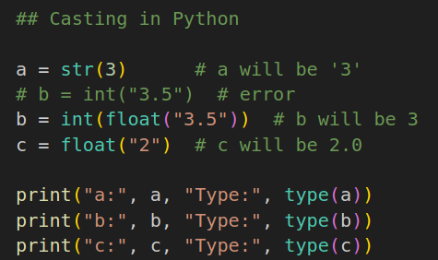


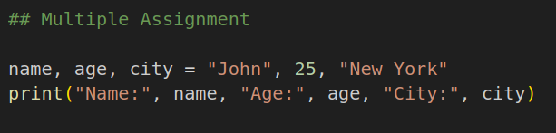
Handling Variables
vars.py is provided.

Slide 7
Arithmetic Operators
There are several mathematical operations supported by Python.
Compound Operations refer to expressions that involve a combination of arithmetic operations and assignment in a more concise way.
A compound operation a += 2 is the same as a = a + 2
5//2 = 2
Refer to operators.py for some simple and compound operations.
% | Modulus | ^ | Bitwise XOR
** | Exponentiation | ~ | Bitwise NOT
// | Integer division | << | Left Shift
& | Bitwise AND | >> | Right Shift
| | Bitwise OR

Slide 8
Strings
Strings in Python can be declared using single (') or double (") quotes. You can exploit this flexibility.
“I’m Mohana and I am poor”
‘I am the poorest “TA” in CS104 ;(’
Escape Sequences: Escape sequences are special characters preceded by a backslash (\) in a string.
\n: New Line
\': Single Quote
\": Double Quote
\\: Back Slash
\t: Tab Space
\b: Backspace (Note: Its behavior might differ between Python 2 and Python 3)

Slide 9
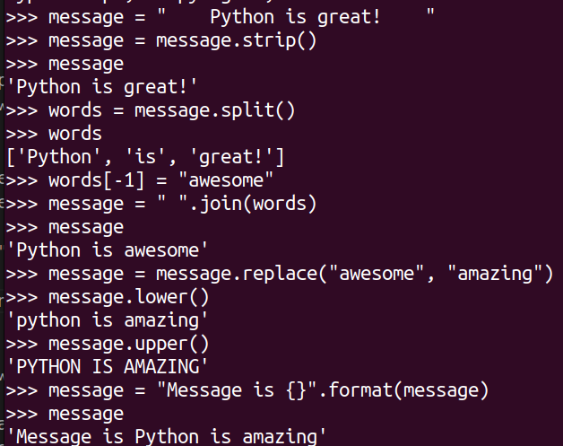
String Methods
+ operator to concatenate strings.
format() method for string formatting.
upper() and lower() to convert into upper and lower case.
strip() to remove leading and trailing whitespace.
split() to split a string into a list of substrings.
replace() to replace a substring with another.
join() to join elements of a list into a single string.
Refer to strings.py

Slide 10
Lists
Lists are ordered, mutable collections in Python.
Elements in a list can be of different data types.
Lists can be created using square brackets [].
Lists are versatile data structures in Python, allowing storage and manipulation of collections of items.
Lists support various operations such as indexing, slicing, updating, and more.
Negative indices can be used to access elements from the end of the list.
len() function provides the length of the list.
List methods include append(), insert(), remove(), pop(), sort(), reverse(), and clear().
List comprehension is a concise way to create lists based on conditions.
Refer the lists.py file, in the shared folder.

Slide 11
Tuples and Sets
Tuples are immutable and suitable for fixed collections.
Use tuples when you want to represent data that should not be changed.
Sets are mutable and allow dynamic modification.
Sets are useful for managing unique elements and performing set operations.
Tuple Methods:
count(x): Returns the number of occurrences of element x in the tuple.
index(x): Returns the index of the first occurrence of element x in the tuple.
Set Methods:
add(x): Adds element x to the set if it is not already present.
remove(x): Removes element x from the set. Raises an error if x is not present.
Refer the tuples_sets.py file in the shared folder

Slide 12
Dictionaries
Dictionaries are unordered collections of key-value pairs.
Keys are unique and immutable; values can be of any data type.
Created using curly braces {} or the dict() constructor.
Example: grades = {'Ana':'B', 'John':'A+', 'Denise':'A', 'Katy':'C'}.
dict[key] or dict.get(key)returns the value associated with the key.
Elements are added using the syntax dict[key] = value.
Existing elements can be modified by assigning a new value to the key.
Elements are removed using the pop(key) method.
for key in dict or for key in dict.keys() explicitly iterates over keys
for value in dict.values() iterates over values
for key, value in dict.items() iterates over key-value pairs
The len(dict) function returns the number of key-value pairs.
Refer the dict.py file in the shared folder

Slide 13
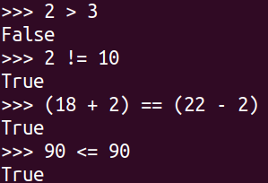
Booleans and Conditional Operators
Booleans are either True or False. In Python, expressions are evaluated and one of the booleans are returned.
TRY: What does type casting bool on another data type do? For eg: bool(27) or bool(“TUB”)
Conditional Operators:
== (Is Equal To?)
!= (Is Not Equal To?)
> (Is Greater Than?)
< (Is Less Than?)
>= (Is Greater Than and Equal To?)
<= (Is Less Than and Equal To?)

Slide 14
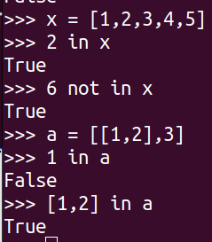
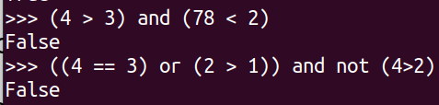
Logical and Membership Operators
Logical Operators are used to combine boolean expressions
and : Returns True iff both expressions are True
or : Returns True if either of the expressions are True
not : Returns the negation of the evaluated expression
Membership operators are used to test if the LHS is present in the RHS.
x in y : Returns true if x is present in y
x not in y: opposite of above

Slide 15
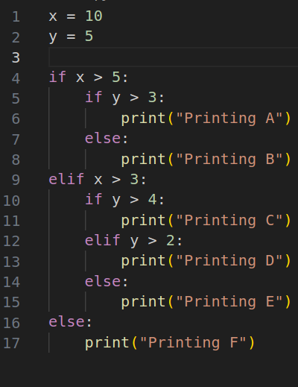
Conditionals
The if statement is used to execute a block of code only if a specified condition is true.
The else statement is used to execute a block of code if the preceding if condition is false.
The elif (else if) statement is used to check multiple conditions sequentially.
Conditional statements can be nested, allowing for more complex decision-making.
Take care of indentation.
Refer to conditionals.py, toggle values of x,y

Slide 16
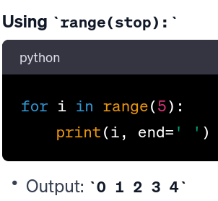
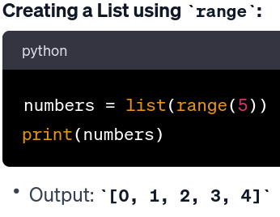
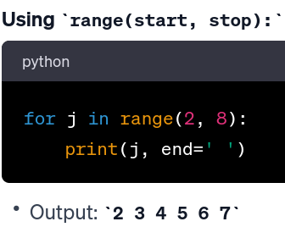
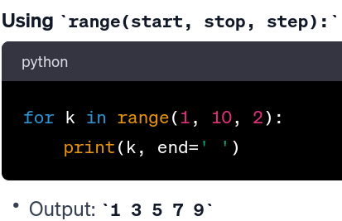
Range function
The range() function in Python is used to generate a sequence of numbers. It can be used in a for loop to iterate over a sequence of numbers.

Slide 17
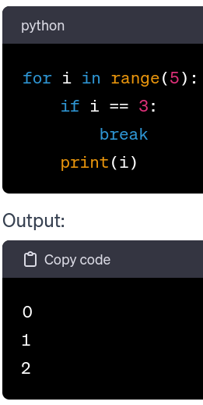
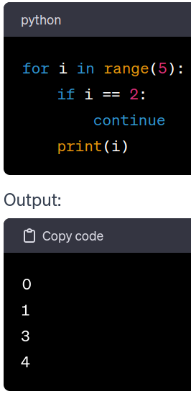
Special Keywords
continue:
Skips the rest of the code inside a loop for the current iteration and move to the next iteration.
It is often used to skip certain conditions and continue with the next iteration.
break:
Exits the loop prematurely, regardless of the loop condition.
It is commonly used to terminate a loop when a specific condition is met.

Slide 18
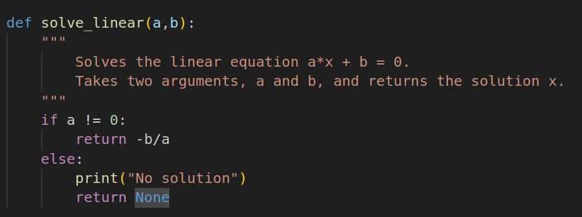
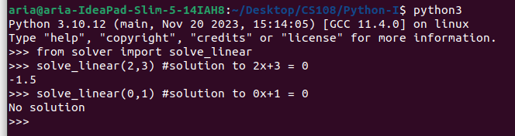
Functions
A function is a reusable block of code that performs a specific task. They help organize code and promote reusability.
Functions are declared using the def keyword, followed by the function name and parameters.
Parameters are variables listed in the function definition.
Arguments are the actual values passed to the function when it is called.
Functions can return values using the return statement.
If no return statement is present, the function returns None by default.
Functions are called by using the function name followed by parentheses () containing the arguments

Slide 19
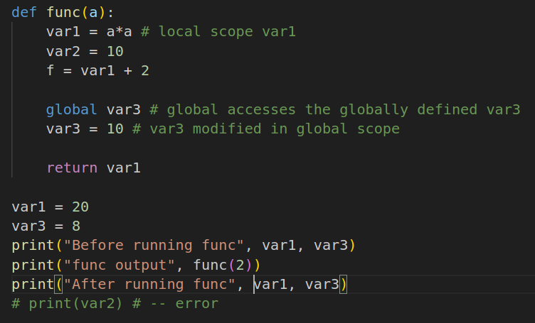

Functions
Scope:
Variables defined inside a function have local scope and are not accessible outside the function.
Variables defined outside a function have global scope and can be accessed throughout the program.
Functions can have default parameter values, which are used if no argument is provided for that parameter.
Refer to solver.py for some demo functions and scope.py to understand local and global scope.

Slide 20
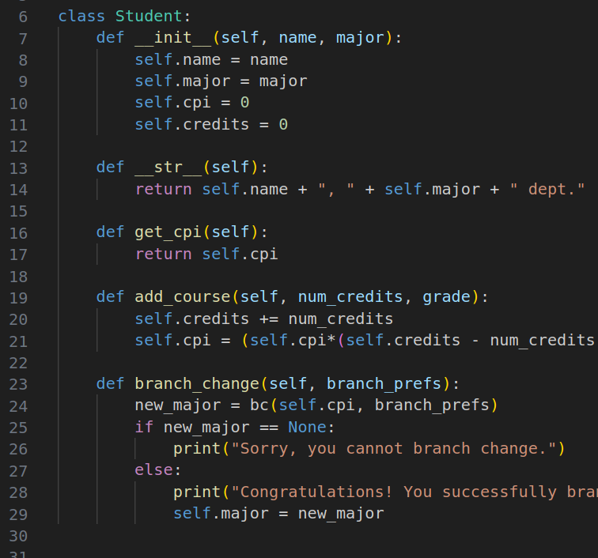
Class
Python supports object-oriented programming (OOP) with the ability to define classes.
Classes encapsulate data and methods that operate on that data.
The Student class represents a student with attributes such as name, major, CPI, and credits.
The __init__ method initializes a student object with default values.
The __str__ method provides a string representation of the student.
Class methods include get_cpi, add_course, and branch_change.

Slide 21
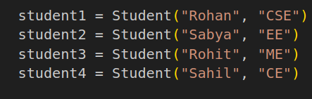
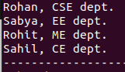
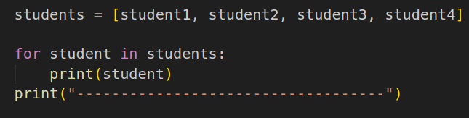
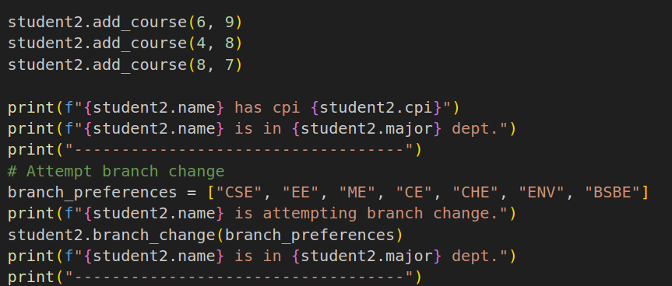
Objects
Four student objects (student1, student2, student3, student4) are created with different majors.
Whenever any student is printed e.g: print(student1), showcases the string representation of each student.
The object attributes can be accessed in this way: student1.name, student2.cpi.
The class methods can be called using: student1.add_course(arg1, arg2).
Refer to student.py

Slide 22
Modules
A module is a file containing Python definitions and statements.
Modules help organize code, making it more manageable and reusable.
Python provides various built-in modules that offer functionalities for mathematics (math), random numbers (random), and timing (time).
Python allows the creation of user-defined modules. Example: solver.py, branch_change.py.
Refer to solver.py, branch_change.py and modules.py

Slide 23
Files
open()
Takes two parameters: filename and mode.
Filename is the name of the file to be opened.
Mode specifies the purpose of opening the file (read, append, write, create).
Modes:
"r": Read (default). Opens a file for reading. Raises an error if the file does not exist.
"a": Append. Opens a file for appending. Creates the file if it does not exist.
"w": Write. Opens a file for writing. Creates the file if it does not exist.
"x": Create. Creates the specified file. Returns an error if the file exists.
read() and readline()
Methods of the file descriptor to read the entire contents of the file and just one line of the file respectively
Refer to files.py

Slide 24
Exercises

Slide 25
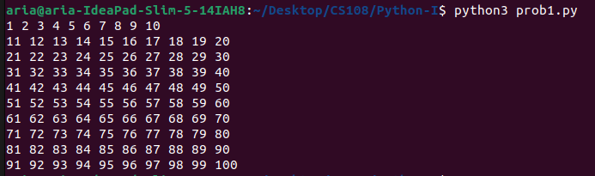
Problem Statement 1
Write a python script without using any external modules to generate output as shown in Fig.

Slide 26
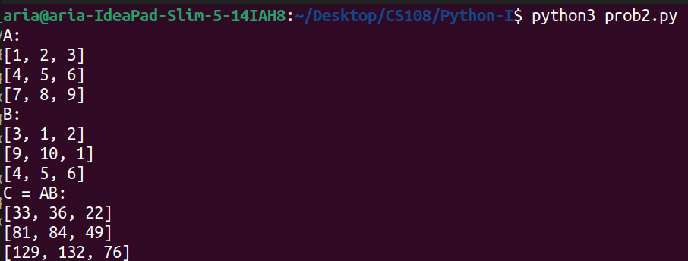
Problem Statement 2
Write a function matmul(A,B) which takes two mxn matrices A and B and returns the matrix product AB. Before performing the multiplication, do a quick sanity check to see if the product is feasible, if not return -1. Matrices are written in the list of list format, with inner lists corresponding to the same row.
Help: Implement the TODO in the prob2_helper.py

Slide 27
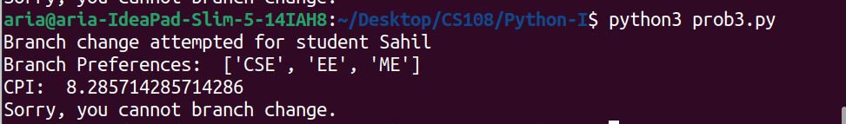
Problem Statement 3
You are given a folder named students, which has information about the courses undertaken and grade scored, for each student in different file. Your task is to create a function, which takes in two arguments, the file path and branch change preferences, and prints the results of branch change on terminal.
Hint: You can import branch_change function
Help: prob3_helper.py provided

Slide 28
Additional Practice
Implement the K Means Algorithm.
def kmeans(data, K):
labels = None
centroids = None
### TODO
return labels, centroids
Note: The algorithm is not part of the syllabus. This assignment is just to test your ability to convert pseudo-codes into actual running code.
Algorithm: https://www.youtube.com/watch?v=4b5d3muPQmA
Solution: https://www.geeksforgeeks.org/k-means-clustering-introduction/

Slide 29
Thank You 🧩 !!!

